Slide 1

IOT DESIGN CHALLENGE
STUDENT LIBRARY ASSISTANT
NCSU WOLVES
Vrushti Shah
Dharin Updhyay
Chetan Pawar
Siddhant Oza
Mentor: Mihir Shah

Slide 2





&
Resources
Type of Application
Android application supported by a web application and beacons
Resources used
IBM Bluemix
NodeJS
BKON Beacons
Android
Native code
Bluetooth Low Energy
IBM DevOps Services (Jazzhub) repository
Application

Slide 3
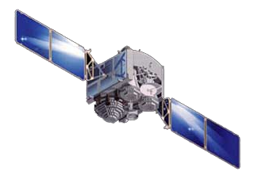
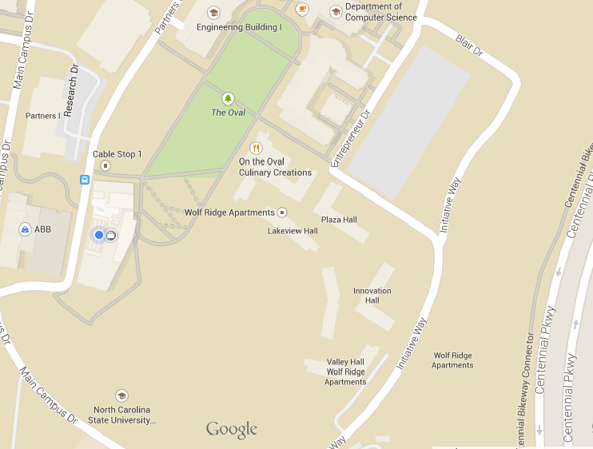
GPS System
Where am I?
Somewhere in here

Slide 4
GPS System
Where inside the building?
Somewhere

Slide 5
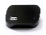

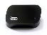
Beacon System
Where am I?
Here

Slide 6



I am B2
Do beacons communicate?
I am B1
I am B3

Slide 7

B1 – left wall B2 – 3rd pillar
B3 – 5th pillar
I am B2
Where am I?
refer
Hmmm..
I hear B1 louder. I am closer to B1, close to B3 but far from B2.
I should be near purple couch.
I am B1
I am B3

Slide 8

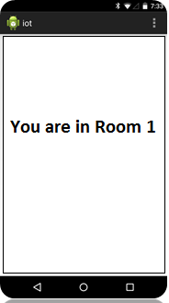
Room 1
Room 2
I am in Room 1 ☺
B1
B2
B1 = -30dB B2 = -60dB
B3 = -90dB
You are in Room 1
Room 3
B3

Slide 9
Room 1
Room 2
I am in Room 2 ☺
B1
B2
B1 = -50dB B2 = -30dB
B3 = -70dB
You are in Room 2
Room 3
B3

Slide 10
DEMO
In case it doesn’t work live, here is the video
www.youtube.com/watch?v=WQ2irbf3-iE&feature=youtu.be

Slide 11
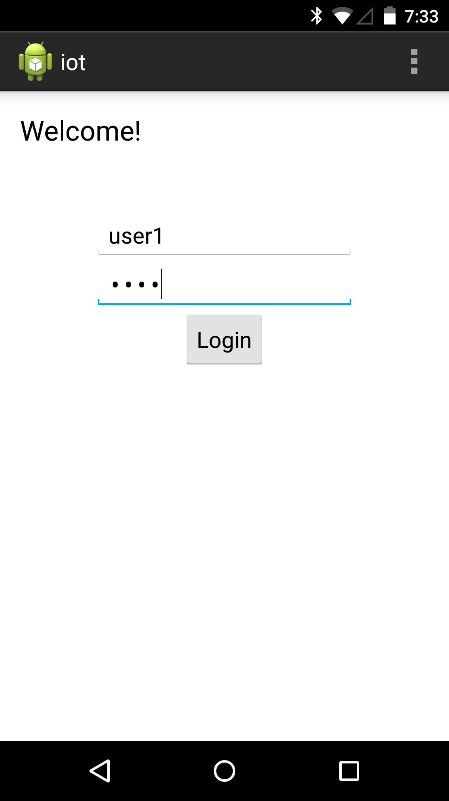
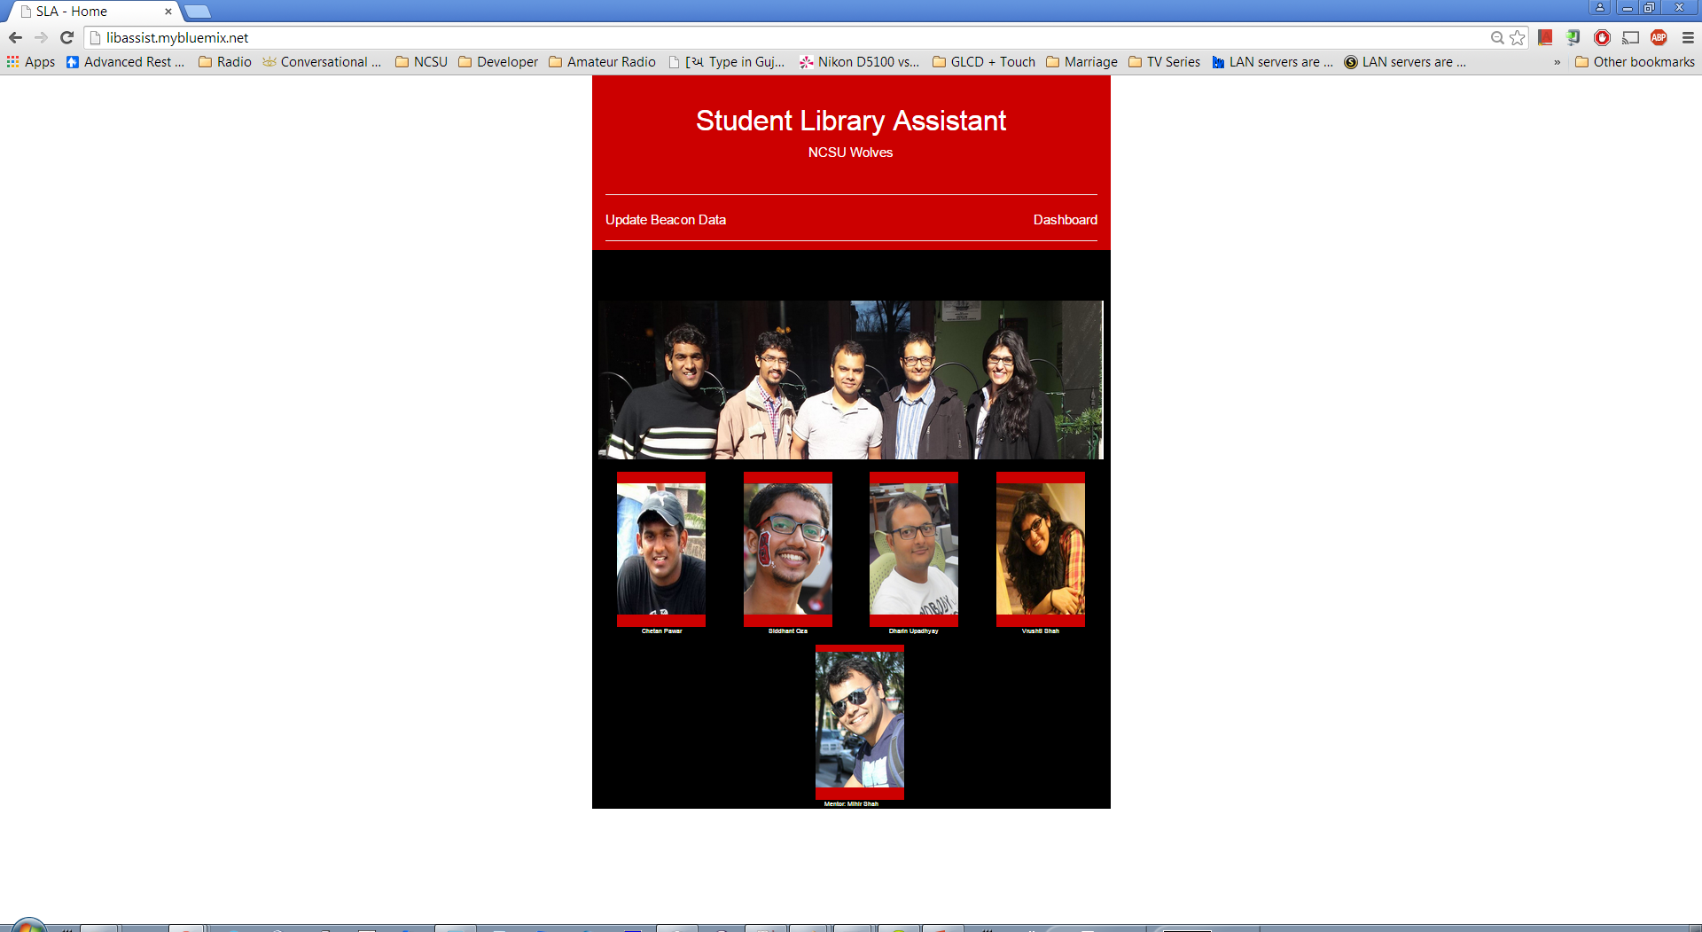
ANDROID APP
WEB APP
START
START
Enter credentials
Listen on endpoint ‘/login’
POST to ‘/login’ endpoint
403 (Unauthorized)
Verify username & password
200
(OK)
Show Location page

Slide 12
ANDROID APP
WEB APP
START
START
Get beacon info
Listen on endpoint ‘/sendstatus’
POST to ‘/sendstatus’ endpoint
Verify username & password
403 (Unauthorized)
200
(OK)
Display location string
Find location

Slide 13



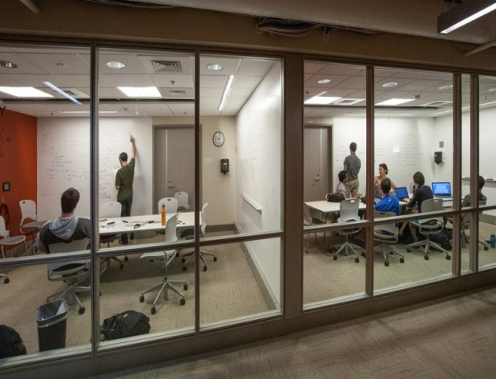
Outcomes
Total number of people in library at a given time
Number of people at any time in a particular place in library
Users can know crowded places by android app
Using main library database, user can know specific books near-by
Available study rooms information

Slide 14
Audience
Administration
Library Administration
Development community
Beacon companies
Indoor navigation application developers
Consumers
Students
Professors
Library staff

Slide 15
Extensions
A very useful user database can be maintained along with common library database.
Issue items, requested items, technology lending, user interest can be integrated in database.
User can choose type of information he/she wants to receive
Library administration can know the times when maximum people come into library
Library administration can know which location or space is utilized the most
In public library, it can help people to navigate between shelves

Slide 16
Market Opportunity
According to per-library use-case, database and required fields in the app can be modified and customized
Placing BKONs in all libraries is not expensive
Cost of 1 beacon = ~$20-$30
Number of beacons per library
If 1 beacon = ~10ft. Radius = ~314 sq.ft. area (bkon.com says ~330ft ! )
Hunt library = ~221,000 sq.ft. = ~700 beacons
Cost to cover Hunt library = ~(700x$25) = ~$17,500

Slide 17
Future Markets:
Retail stores
Eg. Foodlion and Walmart.
Hospitals
Track patients, doctors and nurses
Logistic Compaines
Track packages live
Eg. Amazon
Competitors:
Estimote
Provides similar services and location navigation software
Uniqueness:
No similar application for library use.
Immediate future steps:
In future, Dashboard can be implemented to help library show live maps and help staff

Slide 18
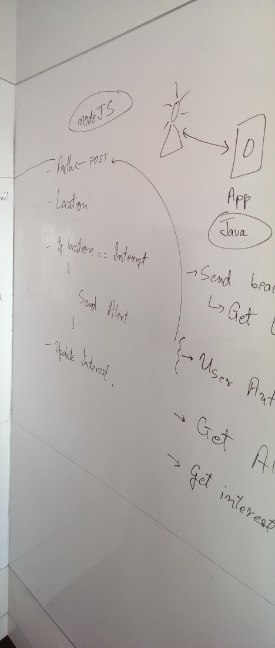
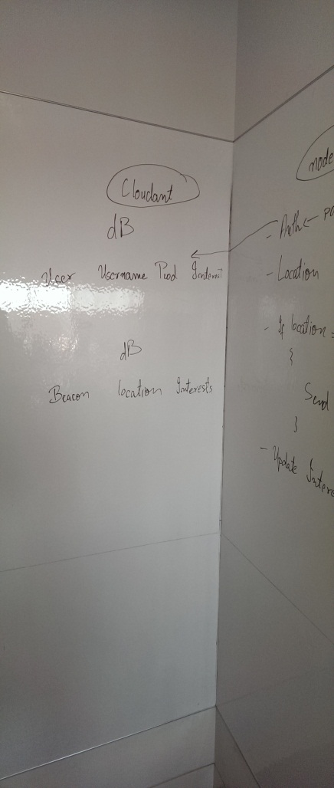
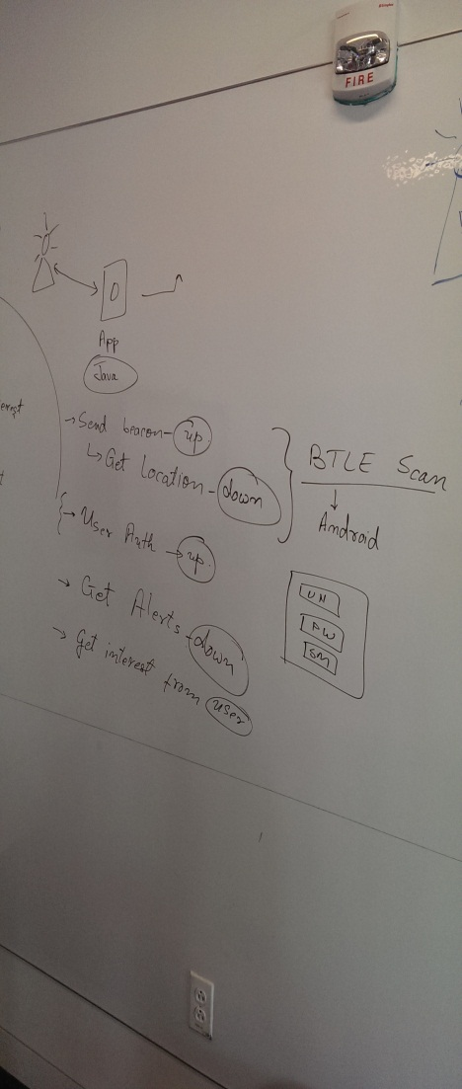

Slide 19
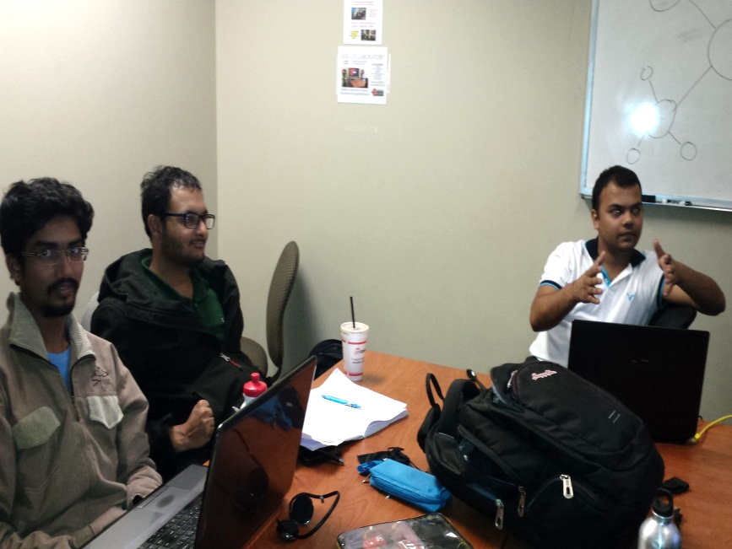
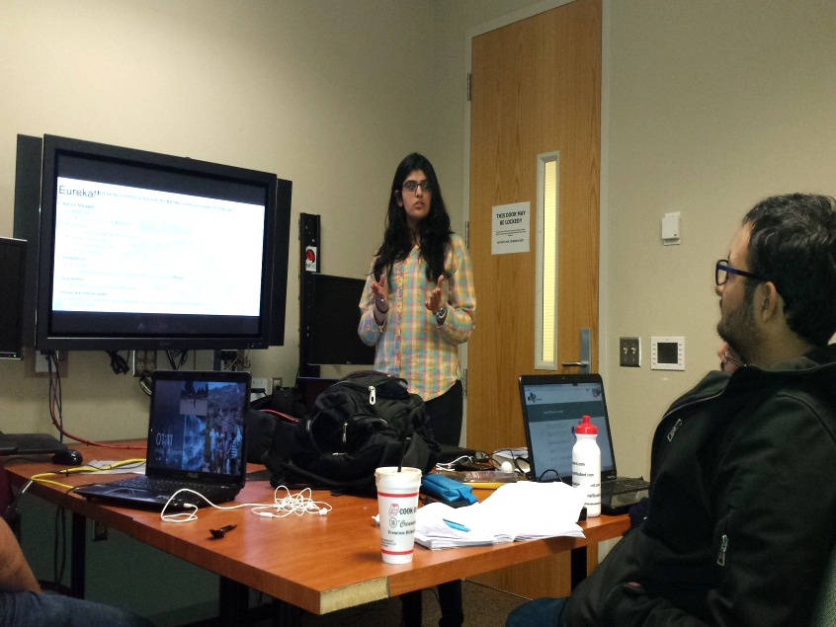

Slide 20
Thank You…

Slide 21

What is a beacon?
A Bluetooth device which broadcasts its ID
as part of its advertisement packet
ID can be broken down into parts
iBeacons – UUID, Major No., Minor No.
UUID – 16 bytes
Major No – 2 bytes
Minor No – 2 bytes
Also broadcasts its transmit power
Enables estimating distance from beacon based on received signal strength

Slide 22

Beacon - Example
Example estimote advertisement packet:
02 01 06 1A FF 4C 00 02 15 B9 40 7F 30 F5 F8 46 6E AF F9 25 55 6B 57 FE 6D 00 49 00 0A C5
02 01 06 1A FF 4C 00 02 15: iBeacon prefix (fixed)
B9 40 7F 30 F5 F8 46 6E AF F9 25 55 6B 57 FE 6D: proximity UUID (here: Estimote’s fixed UUID)
00 49:major
00 0A:minor
C5:2’s complement of measured TX power

Slide 23
Use of Beacons
Use RSSI to calculate distance from beacon
Use distance from multiple (at least 3) beacons to estimate location
b1
b2
You are here
b3
b4

